Slide 1
Shoot for the moon and even if you miss you will land among the stars. You will be further ahead than accepting the status quo.
18 November 2021

Slide 2
Members are CHG’s greatest pride and vice versa, CHG has to be the greatest pride for each member.
Through the power of association, CHG is focused on helping its members build a sustainable competitive advantage – one that comes from internal excellence and external relationships.
Show to each local market that you are a member of CHG, being the pride of our family. CHG: an international organisation with a GloCal view.
Think Globally, act Locally ☺.

Slide 3
Who we are
NEVER FORGET:
To stay relevant by having the right conversations and connections.
To beat competition at value, not with pricing.
Moonshot = aim at 10x impact on the problems, not just a 10% improvement
We are experts in accounting, auditing, taxes and business management and - why not - also in business transformation. Our Clients can trust; we help them make the right choices, connections anywhere in the world thanks to our People, Passion and Commitment.

Slide 4
What each of us does and excels at it.
We are trusted advisors. We nurture client relationships that drive long lasting value as the basis of our business. We do it with honesty, transparency and integrity.
Our clients know they are in safe hands, and they are happy to recommend us.
We are customer centric and committed. We are ready to do whatever it takes to help our clients meet their goals. We know how to handle diverse and complex requirements while staying nimble and flexible. Our dedication is second to none.
We are passionate about what we do. We convey this in the way that we communicate and engage.

Slide 5
However, alone is not enough; what we should do is….
regaining the momentum we got before COVID 19 crisis by showing to the market we are more than just an international association of advisors. We are a group of passionate people who want to provide first-class services across the world;
showing, slightly differently, who we are starting with the CHG website. Today we show who we are as a list of Countries; the thing is we should “tell” the market about each of us.
About the 2nd point, an idea could be in a way like this one….

Slide 6
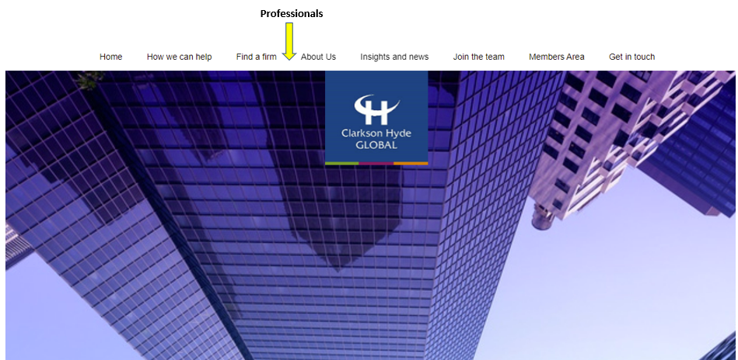
CHG website…
Adding members, by Professionals as well….

Slide 7
CHG website…

Slide 8
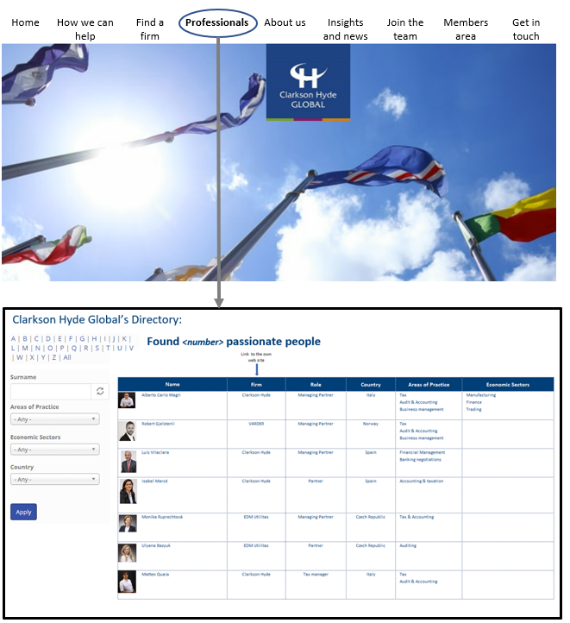
In the CHG website…
Organisation first
Formed out of a unique approach to professional networks, CHG operates on a tailor-made approach, mixing the local knowledge of its firms and the economic specialisation of professionals of the CHG Family. This allows us to create teams specific to the needs of each client, without losing the local factor each member contributes.

Slide 9
QUALITY to be improved!

Slide 10
A willingness to be completely vulnerable with one another to let down our guard, admit our flaws, and ask for help.

Slide 11
Are we sure everyone thinks about Quality in the same terms? What does Quality mean for each member?
Perhaps, could “Quality of service” be the perception that Clients have of how well a service meets or exceeds their expectations?
Some “food for thoughts” for an open discussion:
In firms like ours, where we sell services as specific as accounting, auditing, and tax advice to other companies, and where our main asset is our people; it is more evident that we must not only provide a quality service but also build experiences with our clients, a key element that differentiates us from our competitors. And when we work across different Countries, we must have the same concept of “Quality of service”.
CHG must seek to focus on the value proposition that CHG can offer to the Clients, demonstrating that they matter to us, that we know their needs and that we want to be their “co-pilots” in the growth of their companies. In addition to the “WHAT” and the “HOW” we will deliver our services, we seek to focus on the needs of each of our clients (our “WHY”); always under the premise of independence, confidentiality, and prestige that characterises us.

Slide 12
The quality of services is closely related to human capital
We should establish a challenge to have a well-defined focus on our mutual clients and an orientation towards service to be requested across Countries, which we will only achieve with the best people, and who are able to make a difference every day.
To meet this challenge, my recommendation is that we should:
Set up a Quality Committee (QC), appointed by the members, duration 3 years;
Set up a Talent & Culture Committee (T&C) composed not by Partners but by their Junior Associates seeking from the T&C side, the development of our members.
From Marketing, Quality and Talent, we can establish an emotional relationship between employees and the CHG brand.
With these objectives we could guarantee the motivation of the members, committed and service-oriented, helping them to unleash their growth potential and talent retention. All this will translate into a service culture, customer-oriented, high-quality service, which improves the image and perception of our clients about CHG.

Slide 13
Quality
Only Firms providing high quality standards and excellent professionals, specialised by area of practice, are invited to join Clarkson Hyde Global.
Firm membership MUST be subject to review established by the Board of Directors, through a Quality Committee that should be appointed by the members and should be selected based on strict objective standards and principles, amongst others:
Members must comply with quality norms and accept CHG’s quality control.
Members must provide an impeccable standard of service which must be reliable, efficient and cost effective for the client
Members must actively participate in CHG’s professional activities, such as development and structural activities.
Members must consider Clients of other members as important as their own.

Slide 14
Quality: we must trust each other
CHG members must trust each other by knowing their respective clients are in safe hands within our network.
We collaborate, we listen, we are always ready to help. We are vested in long term relationships with clients, members, employees and partners.
We are open, approachable, easy to do business with, and everyone must feel free to contact each member anytime they need it.
Our members must share CHG values and must know they can use CHG skills to achieve great things.
As part of our constant concern to improve the Quality of our services, we should periodically carry out a “satisfaction survey” of all our members, with which we seek constant improvement through internal feedback.
PROGRESSION not PERFECTION

Slide 15
We are different compared to the other players
We are a “Purple Cow” by being outstanding
Purple cow is a concept developed by marketer and entrepreneur “Seth Godin” that states that organisations must build things worth noticing right into their products or services.
Godin claims that an organisation that isn't in itself unique and somehow outstanding - like a purple cow - is unlikely to sell, no matter how well crafted its advertising.
Purple cow was Godin's addition to the traditional five P's of marketing - product, price, place, promotion and people.
This is how CLARKSON HYDE GLOBAL could be defined: an outstanding organisation of Professionals, linked with each other in a relationship you can find in a Family, and which adds value to Clients.

Slide 16
Why did you choose to join
Clarkson Hyde Global?
Discover why you joined CHG and how your Firm can augment your own expertise and staff through this great network with its Global resources and tools, as well as the collective knowledge and experience of our members.
Advantage: People benefit from extensive professional development and leadership training. Use our human beings, tools and programs to develop talent from «hire» to «retire».
Advantage: Client Service Find the highest quality solutions for your business needs; we’ll go wherever we need to secure the best solution for our Clients.
Advantage: Growth Tap our collective experience in a wide range of industries and service lines through our connection. Reduce your learning curve by connecting to peers who’ve already implemented the projects you’re considering.
Advantage: Firm Management. Keep your technology on track, developing each other’s education and best-practice sharing.

Slide 17
Be independent, but don’t go alone.

Slide 19
Thanks for your attention

